Slide 1
Cross-Domain Image Translation Based on GAN
Wu, 2017/12/19

Slide 2
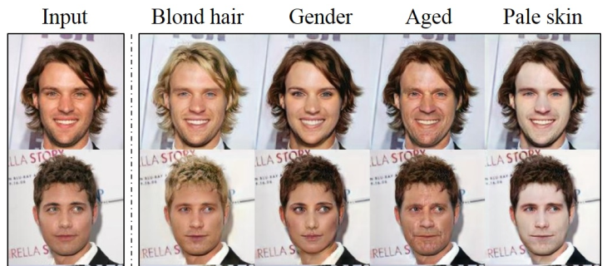

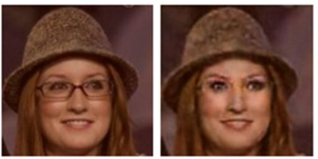
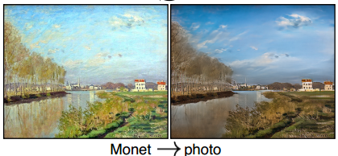
Cross-Domain Image Translation
Domain: a set of images sharing the same attribute value
Examples
Change facial expression
Age Progression
Change seasons
Change or remove some objects
Image Super-Resolution

Slide 3
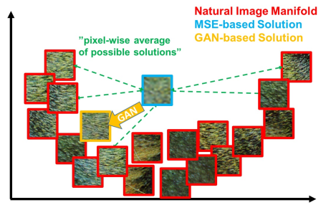
Reason for using GAN
Difficulties of traditional methods
How to design effective loss
How to use unpaired data
GAN’s advantages
No need of the specific loss, but a high level goal
Able to handle unpaired data
GAN’s disadvantages
The Generator network often produce insensitive results
Mode collapse: all inputs are mapped to the same output

Slide 4
Overview of today’s topic
Supervised, Paired Data
Pix2pix: Image-to-Image Translation with cGAN
SRGAN: Photo-Realistic Single Image Super-Resolution Using a GAN
Unsupervised, Unpaired Data
DIAT: Deep Identity-aware Transfer of Facial Attributes
DTN: Unsupervised Cross-Domain Image Generation
CycleGAN: Unpaired Image-to-Image Translation using Cycle-Consistent Adversarial Networks
StarGAN: Unified GAN for Multi-Domain Image-to-Image Translation

Slide 5
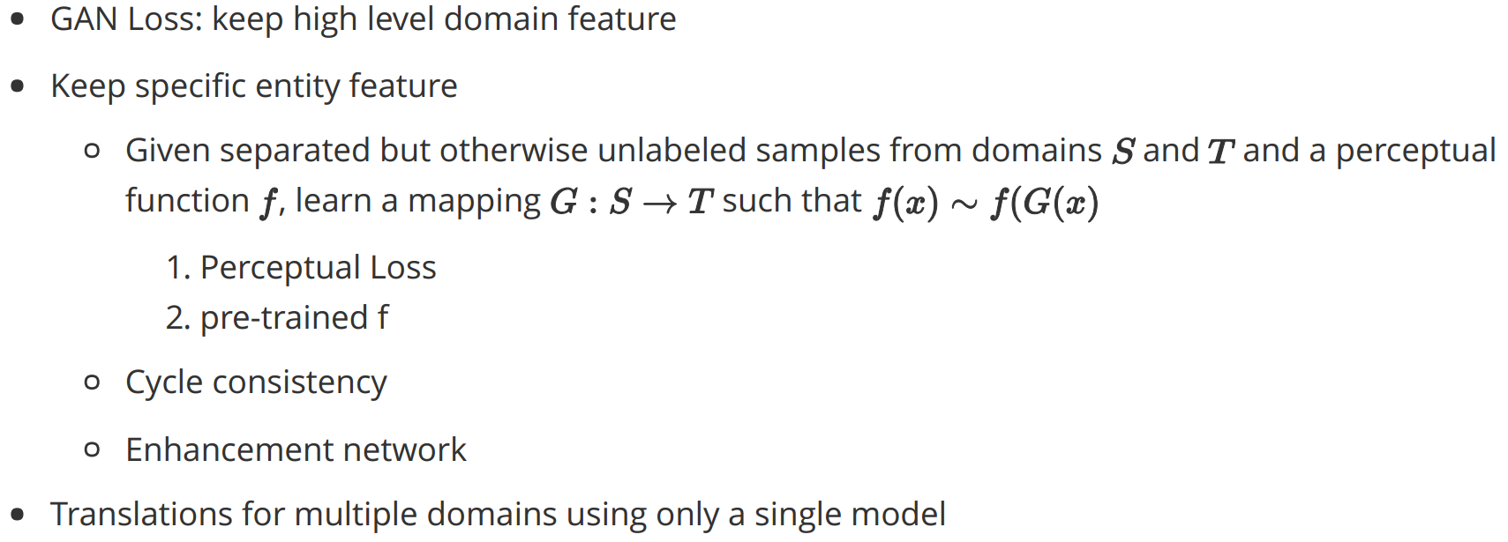
Conclusion

Slide 6
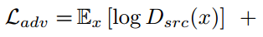
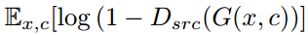
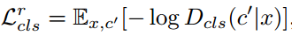
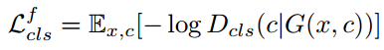
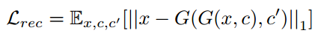
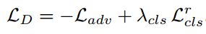
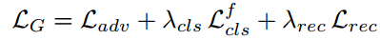
StarGAN Loss
Adversarial Loss:
Domain Classification Loss:
Reconstruction Loss:
Full Objective:

Slide 7
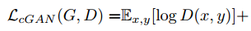
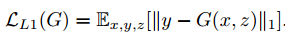
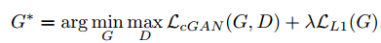
Pix2pix Loss
cGAN Loss:
L1 Loss:
Final objective:

Slide 8
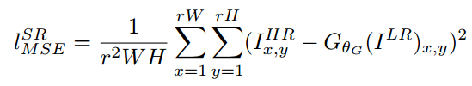
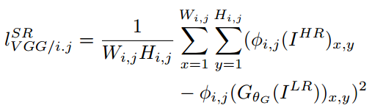
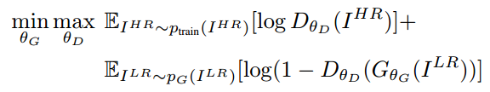
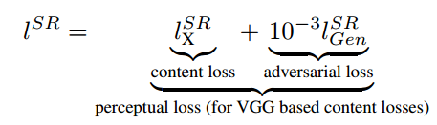
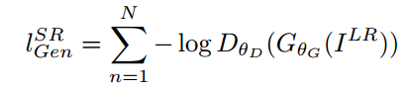
SRGAN Loss
Content loss:
Full Objective:
Adversarial loss:

Slide 9
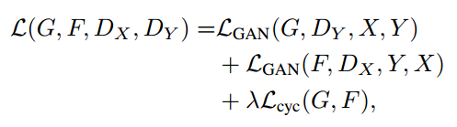
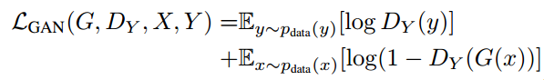
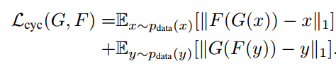
CycleGAN Loss

Slide 10
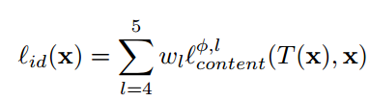
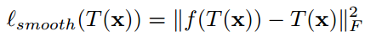
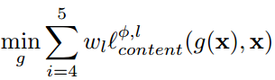
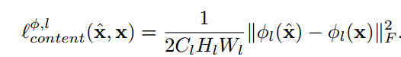
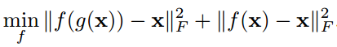
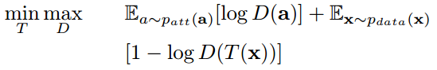
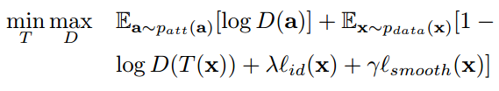
DIAT Transform Network Loss
Identity loss:
Perceptual regularization:
Attribute loss:
Final Loss:

Slide 11
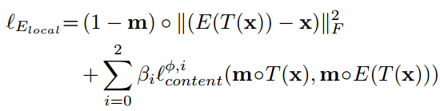
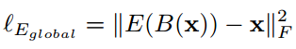
DIAT Enhancement Network Loss
Pixel loss
Perceptual loss

Slide 12
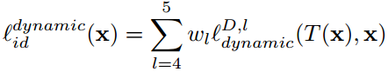
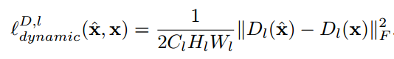
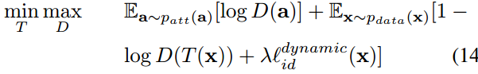
DIAT-A Transform Network Loss
Adaptive perceptual identity loss:
Final loss:

Slide 13
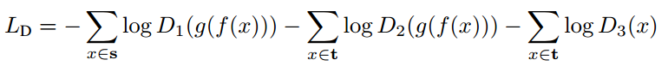
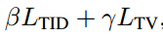
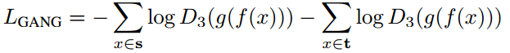
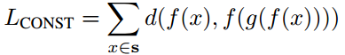
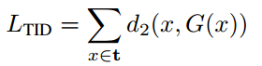
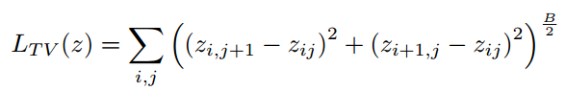
DTN Loss

